Slide 1
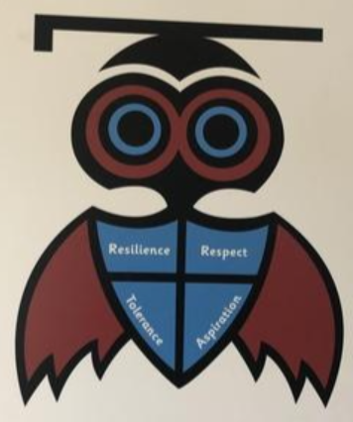
The Spiritual Life of our School

Slide 2

Our definition of spirituality
“Spirituality is not something we can see; it is something we feel inside ourselves. It is about awe and wonder, asking questions, inspiration and being aware of something ‘bigger’ outside of ourselves.”

Slide 3



The Ow, Wow and Now Times
OW times are those when we experience something which affects us negatively. They might be:
  the loss of a loved one
  a difficult day at school
  some sad news in the world
WOW times are those when we experience something which affects us positively. They might be:
  seeing something beautiful for the first time
  making some progress with something challenging
  witnessing someone else’s happiness
NOW times are those when we experience something ordinary. They might be:
  daydreaming and not having a care in the world
  pondering something and getting lost with your own thoughts
  letting feelings dominate the moment

