Slide 1
Courageous Advocacy: Starting with why.

Slide 2
Courageous Advocacy
The act of speaking out against an issue of injustice, often on behalf of those whose voice is not heard.
Is it easy?

Slide 3
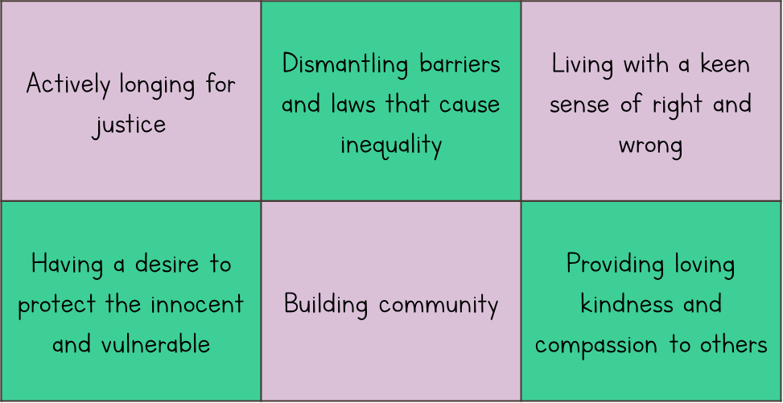
As a church school we hope to instil these values within our pupils

Slide 4
Research Findings
What activities have children participated in at school at least once in the past year?
Protest/Campaigns
Campaigning a school issue
Community projects/social action
Fundraising for local charities
National fundraising campaigns
Fundraising for school funds.
3%
16%
44%
53%
66%
67%

Slide 5
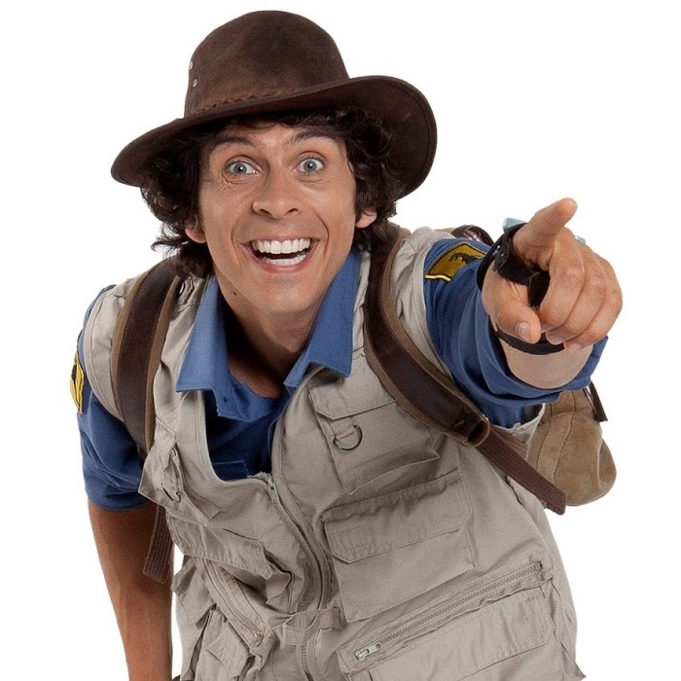
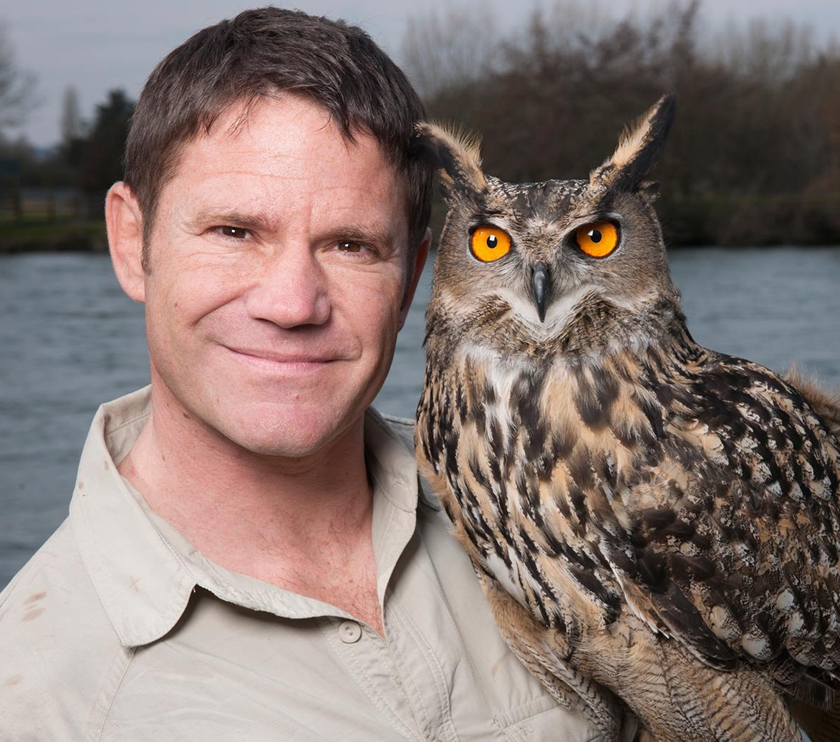
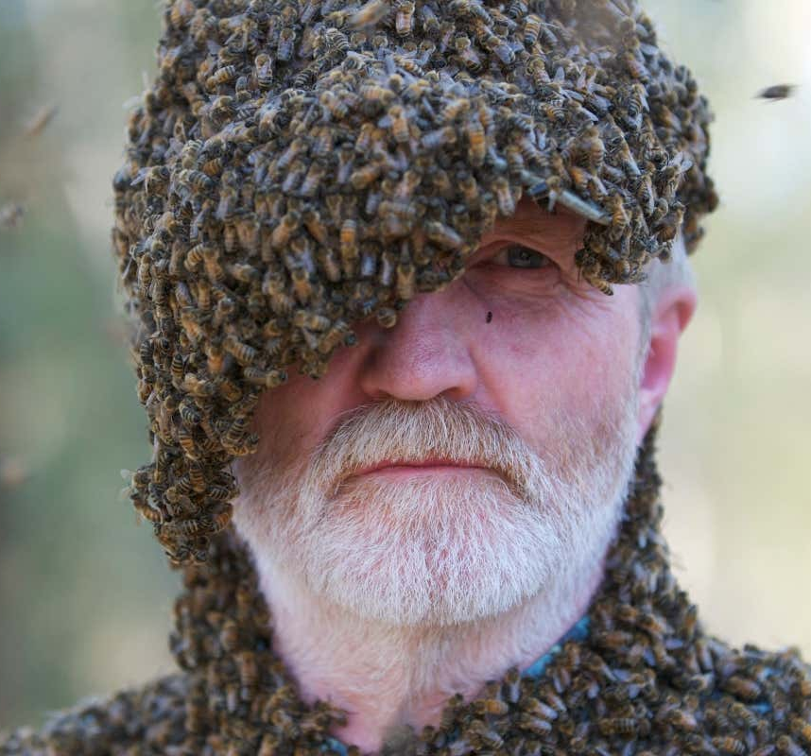
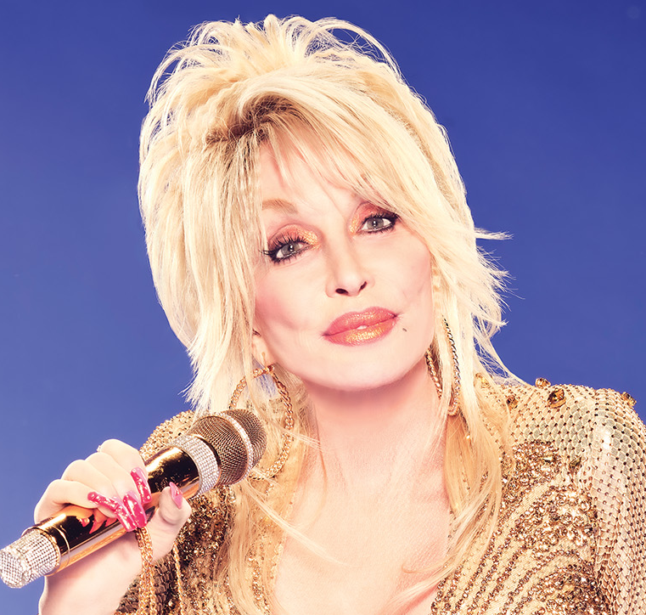

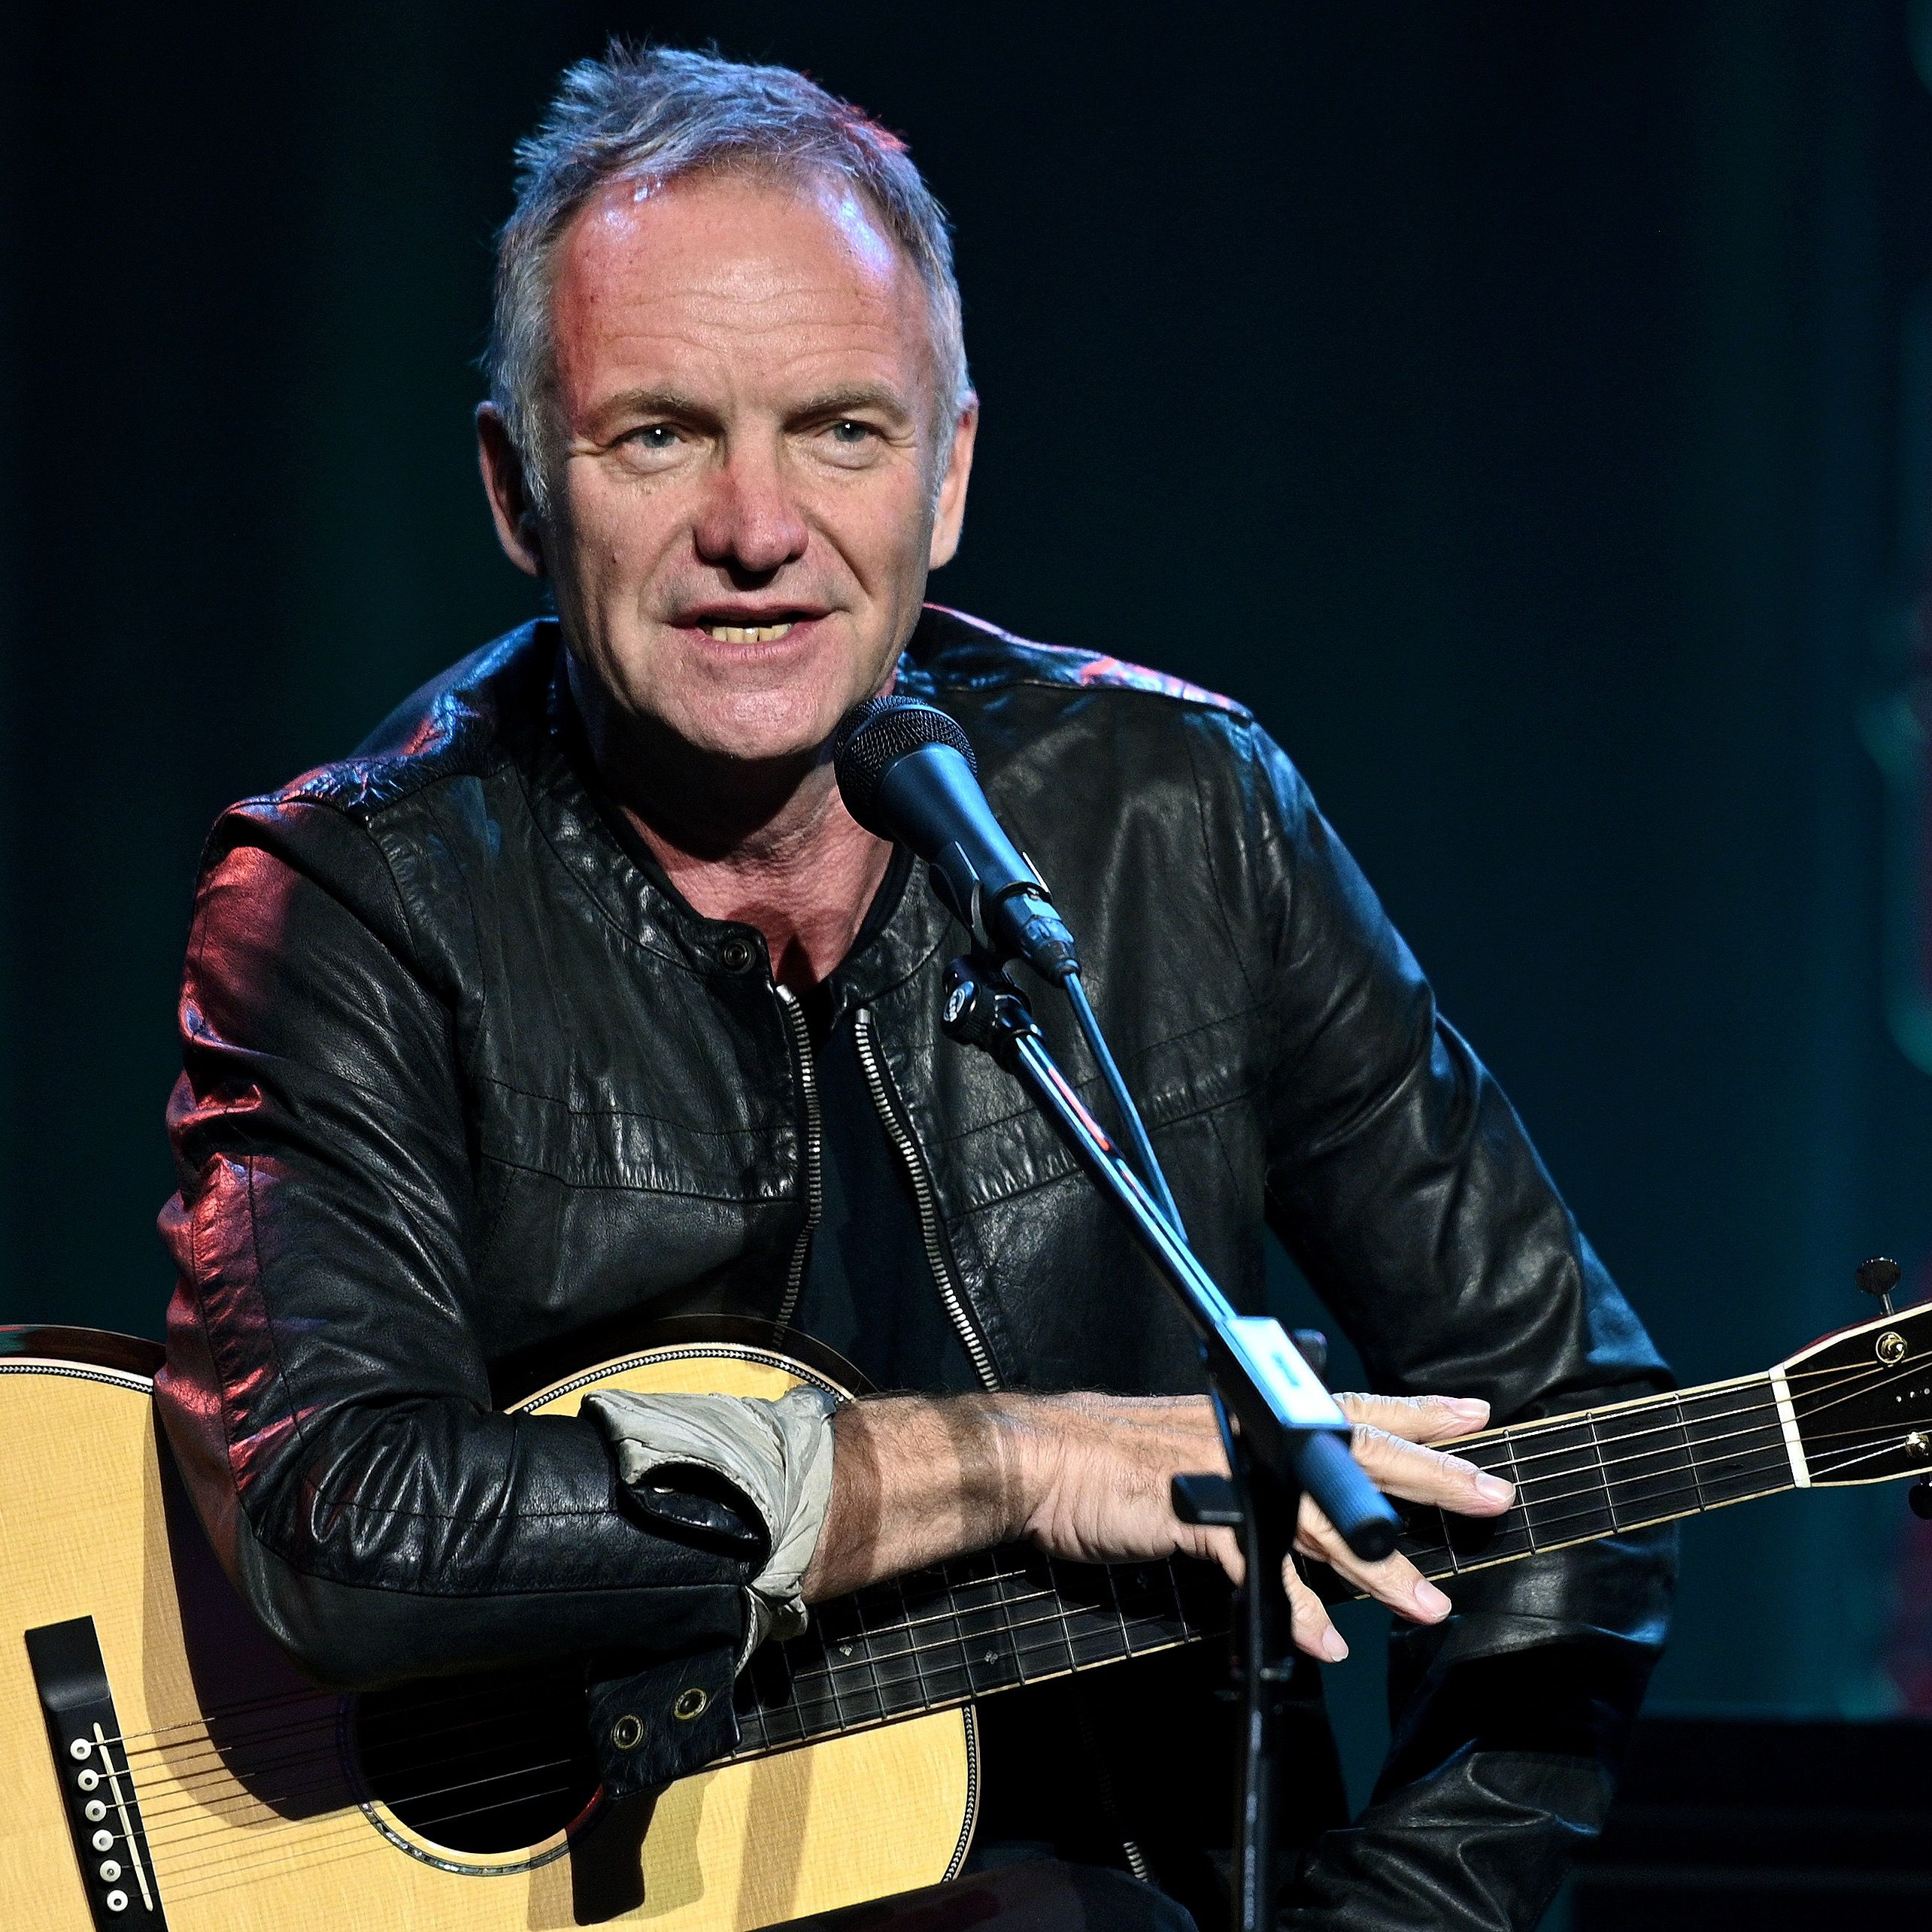
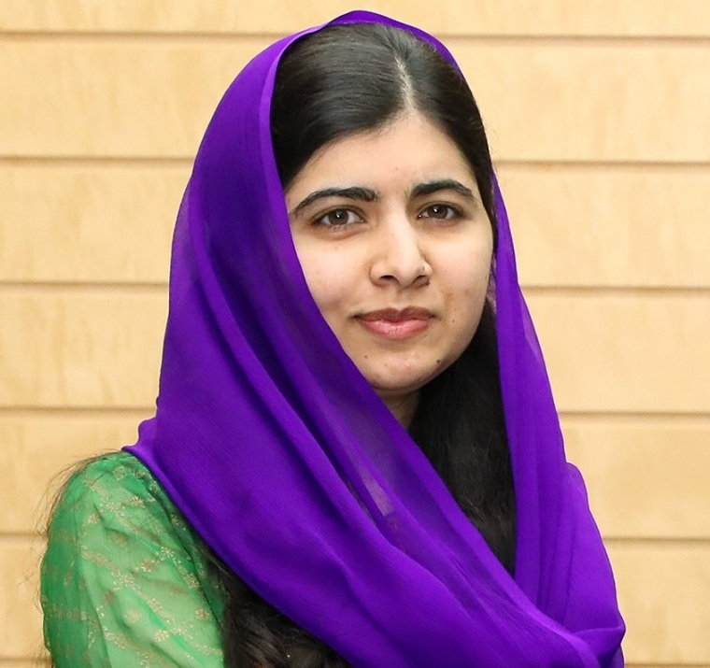
How are we starting in school?
YR – Andy Day
Y1 – Steve Backshall
Y2 – George McGavin
Y3 – Dolly Parton
Y4 – Harry Gregson
Y5 - Sting
Y6 – Malala Yousafzai

Slide 6
What are you passionate about?
Think about where you live or our school.
What needs to change? WHY?

Slide 7
How?
What is the problem?
Why is it a problem?
How can the problem be solved?

Slide 8
How will we approach an issue we want to tackle?
Identify
Consider
Improve
Issues/problems – relevant to context of the school
Investigate as much as you can so you understand: consider all views
Work out what could be done to improve/change?
Persuade
Voice
Influence
Persuade those in power to make changes and do something
Whose help you might use to make your voice more persuasive?
WHO can make the change?

Slide 9
Being Courageous Advocates
What are the social and environmental issues that you currently explore?
What are your children passionate about?
Courageous advocacy requires a willingness to be vulnerable and to take a stand, even when it may not be popular or easy. It is a powerful way to effect change and make a positive impact on the world.

