Slide 1

Growth Mindset parents’ information workshop
OCTOBER 2026

Slide 2
Today’s agenda
What is growth mindset?
Why have we decided to encourage Growth Mindset in our school?
How are we encouraging a Growth Mindset?
How can you help your child develop their mindset?

Slide 3
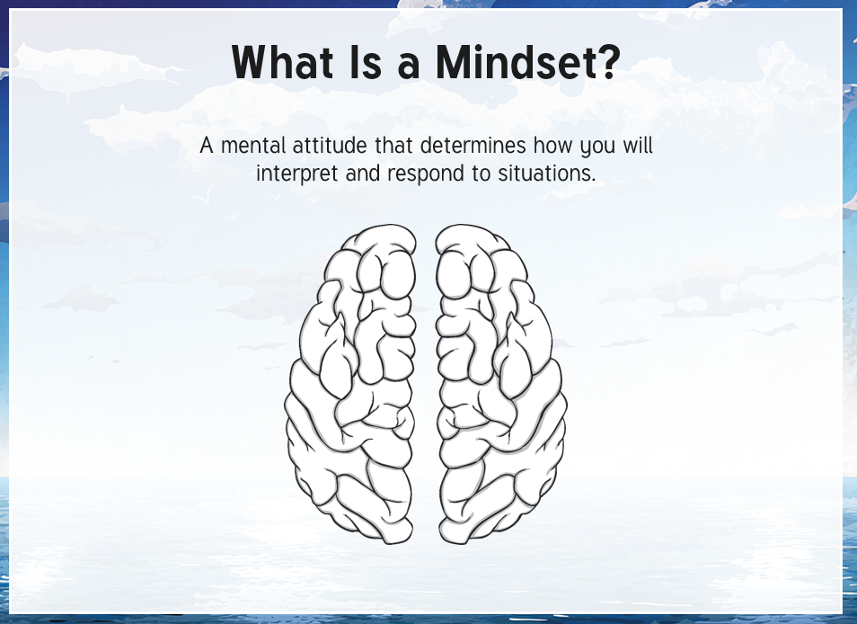

Slide 4
What is growth mindset?
A growth mindset is a belief that basic abilities are not fixed and that intelligence can be developed over time. Through effort and determination, intelligence and basic qualities can grow.
A person with a growth mindset might say ‘I did well on that test because I worked hard’ or conversely, ‘I got all the questions wrong but I understand why and next time I will not make the same mistakes again’.

Slide 5
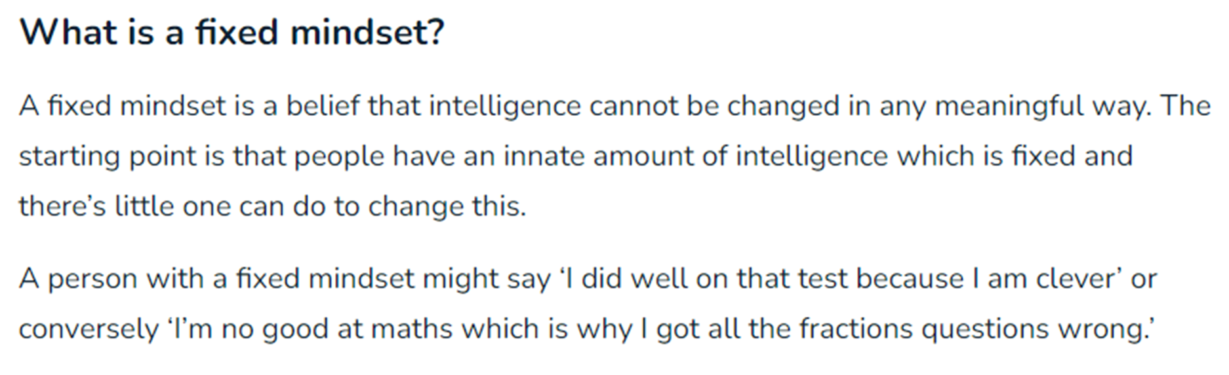

Slide 6
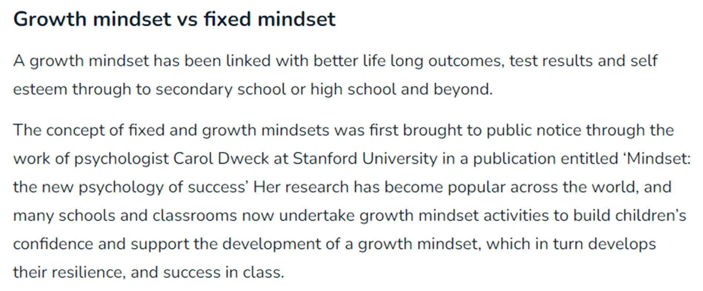

Slide 7
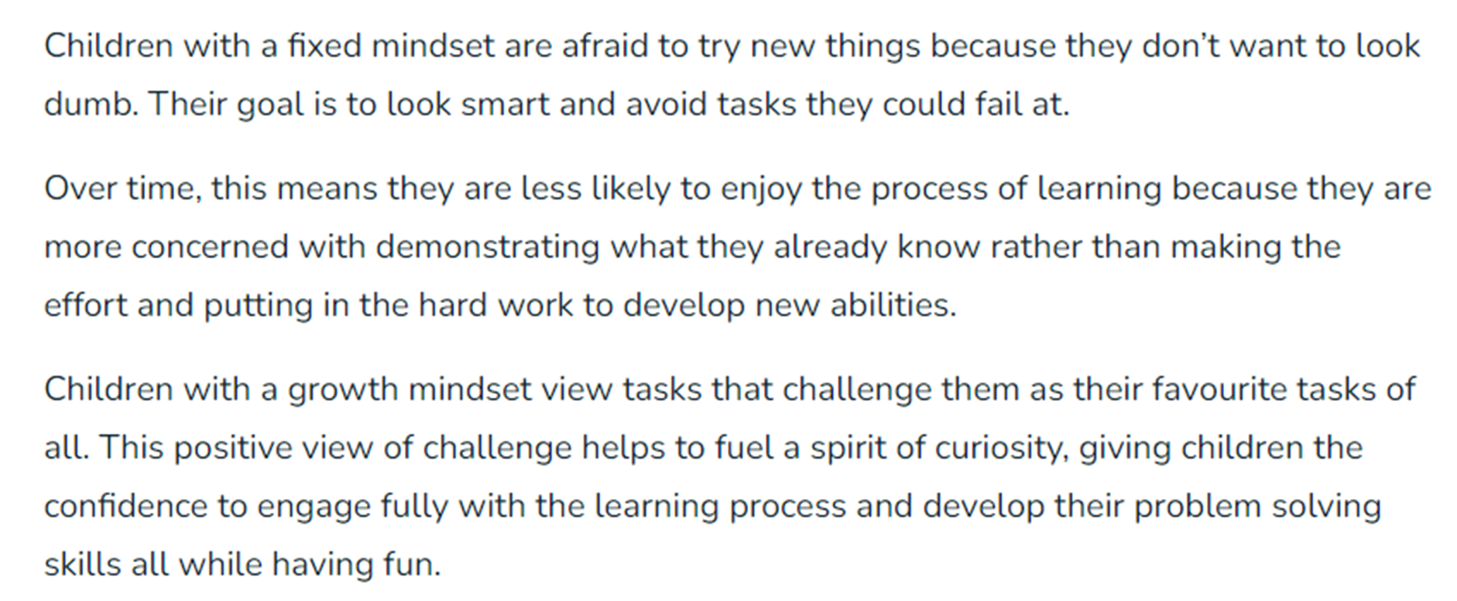
Why have we decided to encourage children’s development of growth mindset?
1. A growth mindset will increase a child’s love of learning

Slide 8
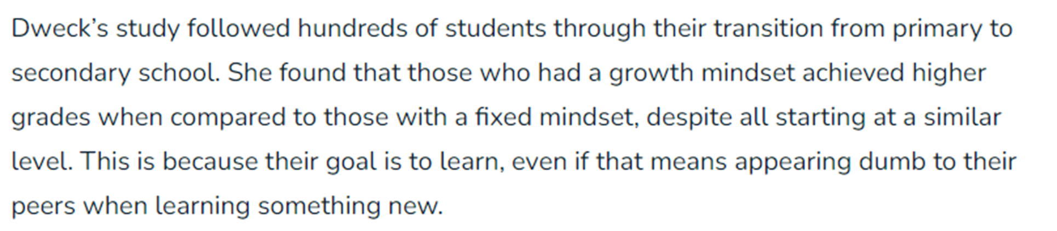
Why have we decided to encourage children’s development of growth mindset?
2. Having a Growth Mindset will encourage children’s progress.

Slide 9
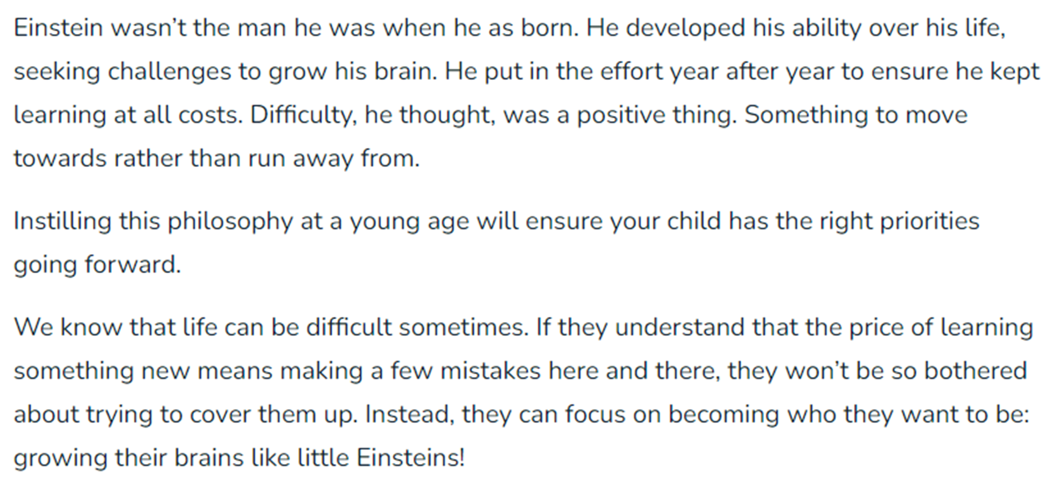
Why have we decided to encourage children’s development of growth mindset?
3. Having a Growth Mindset will set a child up for life.

Slide 10
https://www.youtube.com/watch?v=Yl9TVbAal5s

Slide 11

Why should we encourage a growth mindset at the Alvey?
Some children lack resilience and perseverance in tasks.
Some children display low self-esteem when it comes to their learning.
Some children have a fixed mindset.
Impact on attainment.
These children can take longer to secure a concept due to lack of confidence and the fixed mindset culture (the idea of right/wrong).
These children tend to give up quickly if they think tasks are too challenging.

Slide 12
We want our children, and staff, to have access to techniques that will enable them to develop their resilience so they can face life’s many challenges.

Slide 13
How are we developing a growth mindset with our pupils?
We use our language carefully.
We use open questioning.
We teach children to love challenges.
We create mistake friendly classrooms.
We ensure our environments reflect a Growth Mindset.
We praise the process not the person.
Weave Growth Mindset throughout all our lessons.
Mission Possible Days

Slide 14
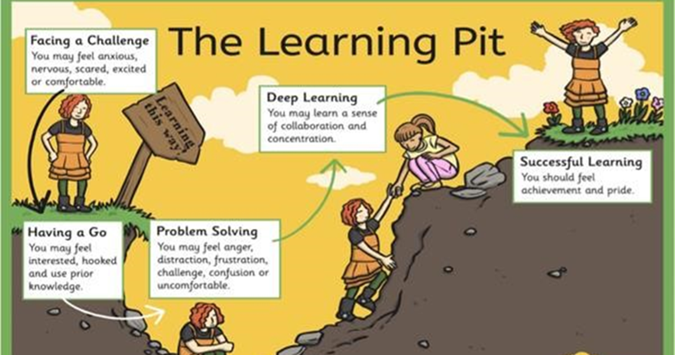

Slide 15
How can you help your children to develop a growth mindset?
Consider your own mindset – recognise your mindset and consider your words and actions.
Praise the process: Praising children for being smart suggests that innate talent is the reason for success, while focusing on the process helps them see how their effort leads to success.
Model learning from failure: When parents talk positively about making mistakes, kids start to think of mistakes as a natural part of the learning process.
Choose tasks at home that will challenge them.
Focus on the strategies needed to succeed.

Slide 16
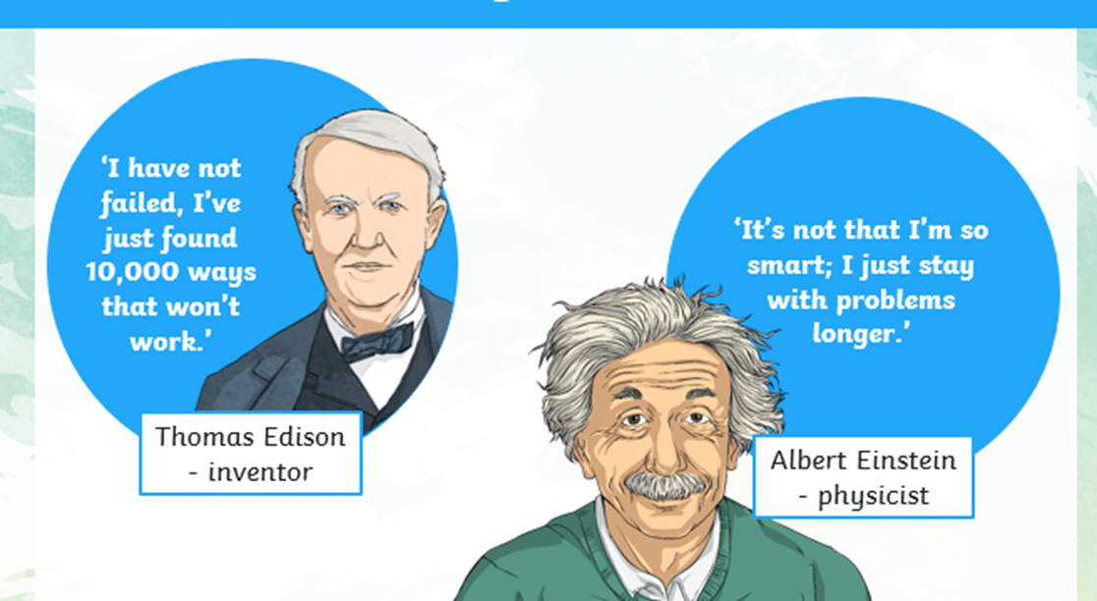
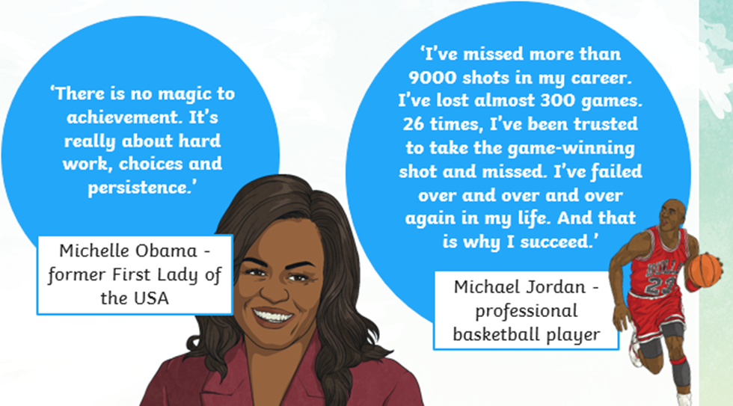
Use famous people they know and discuss their challenges

Slide 17
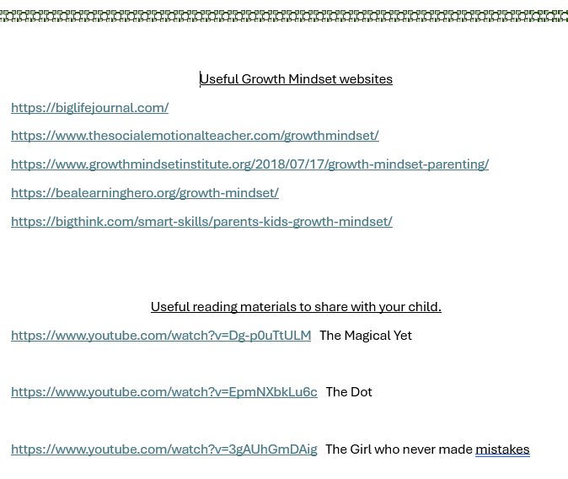
Some extra information

Slide 18
Thank you all for coming.
Any questions?

